Slide 1
Report of IOTA/ES activities for the Annual IOTA Meeting 2020
Konrad Guhl (president@iota-es.de)
www.iota-es.de

Slide 2
Brief report on IOTA/ES activities:
- Continuous observations of occultations by objects of the solar system. Highlights were (2) Pallas and (87) Sylvia.
- Publishing of the Journal for Occultation Astronomy (JOA)
- Annual meeting “European Symposium on Occultation Projects (ESOP)”; last year held at Paris Observatory
- Collective purchase of 31 QHY174M-GPS cameras to raise the standard of observations. Workshop for using the camera with the software SharpCap in Berlin.
- Construction and deployment of the mobile 20" telescope "M2", even in Namibia.

Slide 3
Continuous observations of occultations by objects of the solar system.
- 180 positive reports in 2019 at euraster.net (Thanks to Eric Frappa!)
- First half of 2020: already 134 positive observations, including 46 multi-chord observations.
- Increasing number of multiple positive observations (→ chords, → DAMIT 3D models)
- Further improvement of 3D models for observation campaigns:

Slide 4
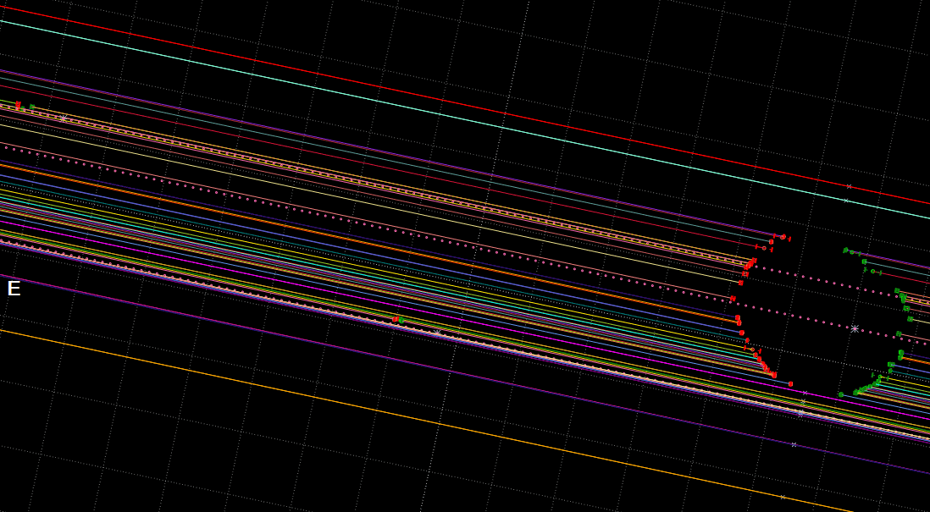
Highlights were the (2) Pallas and (87) Sylvia events.
- 36 positive observations of (87) Sylvia on 2019/10/29
Even both moons were detected.

Slide 5
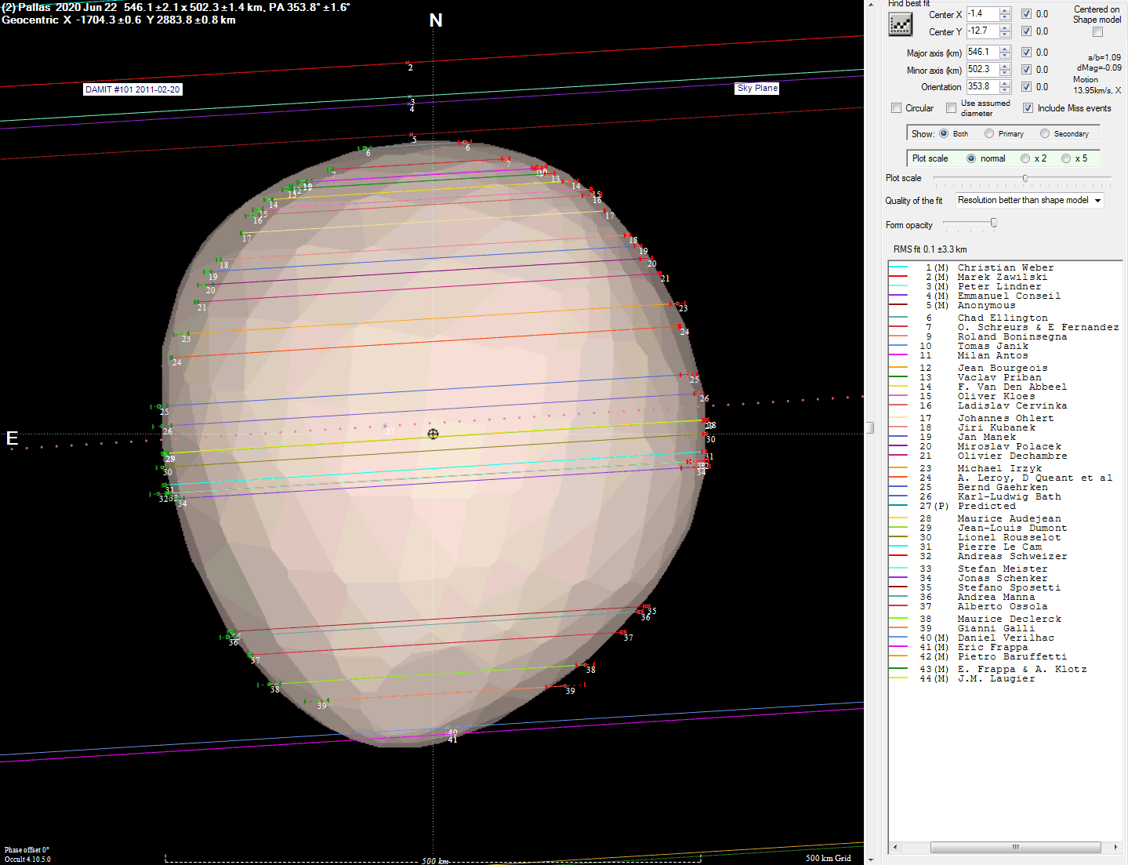
Highlights were the (2) Pallas and (87) Sylvia events.
- 34 positive observations of (2) Pallas on 2020/06/22
improvement of the existing 3D model

Slide 6
Publishing of the Journal for Occultation Astronomy (JOA)
Since 2011 the IOTA/ES publishes the successor of the “Occultation Newsletter (ON)”.
JOA is always published at the beginning of a quarter.
The editorial team will be increased in the near future. Articles and reports for JOA are always welcome.

Slide 7
Annual meeting: European Symposium on Occultation Projects (ESOP):
12 times in Germany
5 times in Czech Republic
4 times in Poland
3 times in UK and Italy
twice in B, NL, SP and F
once in DK, SU, SK.
In 2019 the ESOP took place in Paris. With 80 participants the limit of the conference location was reached.
ESOP 2020 will only take place online on August 29/30.
ESOP is planned 2021 in Poland and 2022 in Spain.

Slide 8
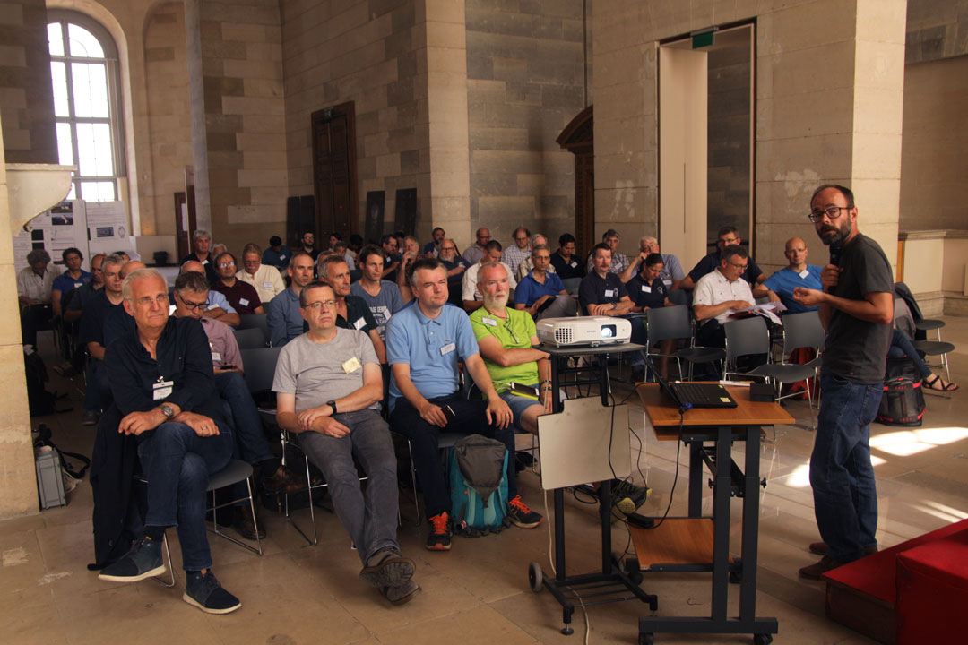
European Symposium on Occultation Projects
ESOP 38 in 2020 In the venerable Cassini Hall of the Paris Observatory Image: lesia.obspm.fr

Slide 9
Collective purchase of 31 QHY174M-GPS cameras
Precise timing is essential for occultation observations. But with 12-bit cameras this can become a problem.
At ESOP 38 in 2019 the company QHYCCD was present as sponsor. The contact for a collective order was established.
Already at the ESOP, 25 participants registered as interested parties.
31 cameras were finally sold to IOTA/ES members.
Since working with this camera is not too easy, a workshop was held on 29 February 2020.

Slide 10
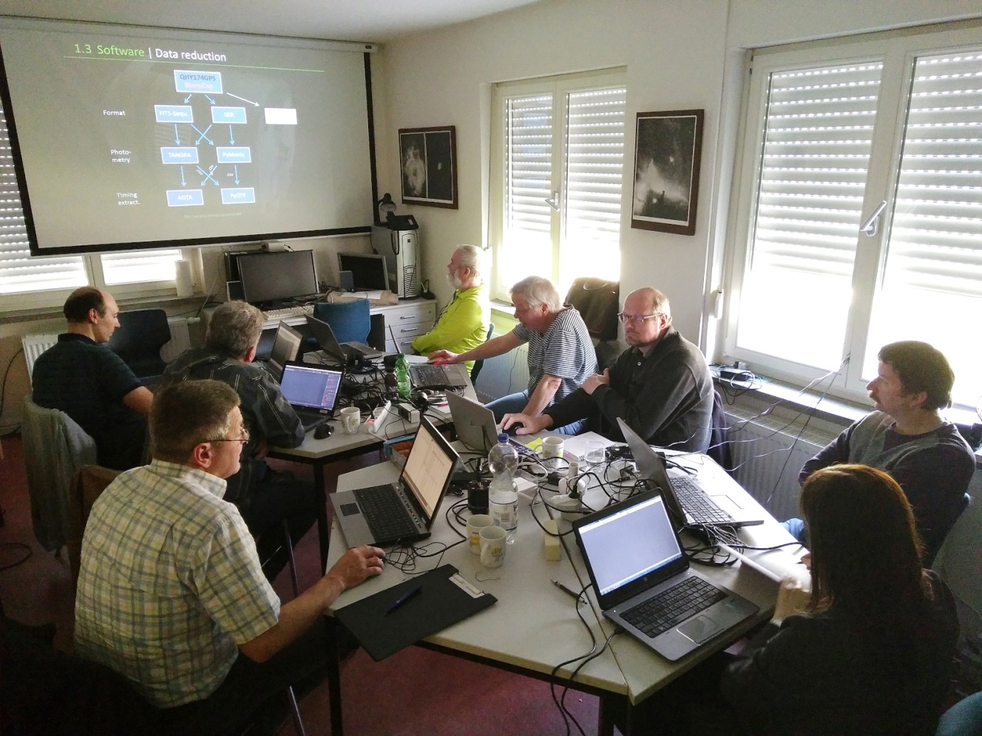
Using of the camera QHY174M-GPS – a workshop in Berlin on Feb. 29., 2020
15 participants from three countries came to Berlin.
See here for results and tutorials:
https://www.iota-es.de/qhy174gps_workshop.html

Slide 11
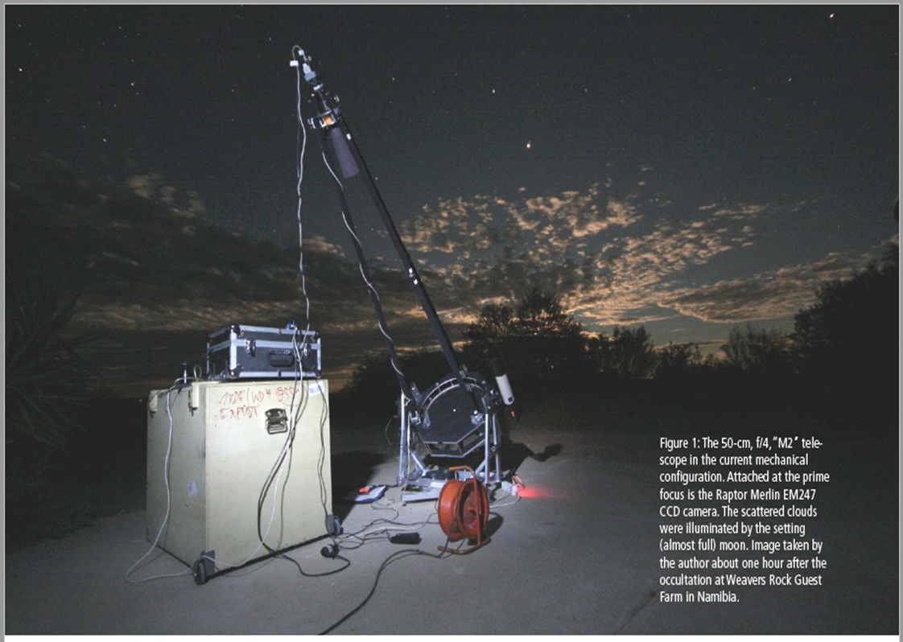
IOTA/ES designed and built the mobile 20" telescope "M2".
It is especially designed for occultation events.
The camera is located directly in the focus of the main mirror.
Scientific results have already been published several times in "JOA".

Slide 12
Some other activities:
OHY174 tested with SEXTA (Weber)
Beta-Testing DVTI (Dangl, K. L.Bath, Weber),
Deep analyse GPS-characteristic and firmware update of QHY174 camera (Weber)
Continously software testing „SharpCap“ (Wuensche, Weber, Kloes et al.
Test to timing CMOS cameras for „TANGRA“ Software (Pawlow, Kloes, Wuensche, Weber)
Discussion with R. Anderson for improvement PyMovie/PyOTE(Manek, Weber)
Discovery of new double stars (Pratt et al.)

Slide 13
Thank you….
IOTA/ES

